Slide 1
NATIONAL INSTITUTE OF TRANSPORT
ENGINEERING MEASUREMENTS AND INSTRUMENTATION II
Lecture 01: variable conversion elements course Lecturer: Eng. Khadija o. Mohammed

Slide 2
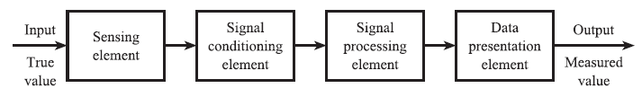
PERQUISITE (FUNCTIONAL ELEMENTS OF AN INSTRUMENT FROM MEU 07108)

Slide 3
Introduction to variable conversion elements
Variable conversion elements in the measurement system are elements which converts the non-voltage form sensor outputs into a signal form which is more convenient.
These non-voltage sensor outputs includes translational displacements and changes in various electrical parameters such as resistance, inductance, capacitance and current. In some cases, the output may alternatively take the form of variations in the phase or frequency of an a.C. Signal.

Slide 4
Types of variable conversion element
For the purpose of our study we will learn about the most important type of variable conversion elements which is the bridge circuit.
Bridge circuit provide an accurate method of measuring resistance, inductance and capacitance values, and enable the detection of very small changes in physical quantities about a nominal value.
They are of immense importance in measurement system technology because so many transducers measuring physical quantities have an output that is expressed as a change in resistance, inductance or capacitance.

Slide 5
Classes and types of Bridge circuits
Bridge circuits can classified into D.C and A.C bridge circuits. They are also divided into two types which may exist in either of the mentioned categories.
These are Null type and deflection type where the latter is used within closed-loop automatic control schemes and the other is employed for calibration purposes

Slide 6
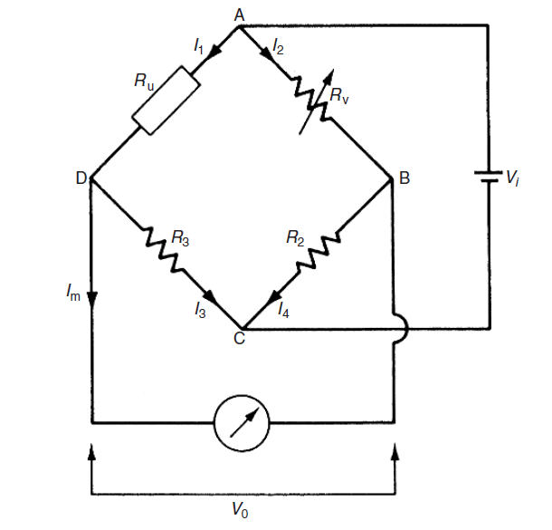
Dc bridges : (null type)
Wheatstone bridge
This is how the null type D.C bridge form is, derivation will be done on the board

Slide 7
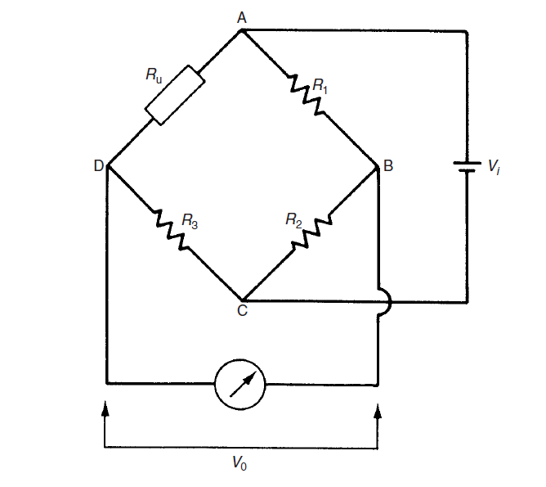

Dc bridges : (deflection type)
This is how the deflection type D.C bridge form is, derivation will be done on the board. It mainly differs from Wheatstone bridge on the variable resistance where by for this case the variable resistance is replaced by a fixed resistance i.e.

Slide 8
Example 1
Refer to example 7.1 from the book. Lets brief for five minutes and do it together in class

Slide 9


